Slide 1
A Practical Guide for Reproducible Papers
Aurora Blucher, PhD Postdoc, Mills Lab, Knight Cancer Institute
Ted Laderas, PhD
Assistant Professor, DMICE
Head and Neck Project Repository
https://github.com/biodev/HNSCC_Notebook
Reproducible Paper Repository
https://github.com/ablucher/Workshop_ReproduciblePaper

Slide 2
Workshop Overview
Creating a Strategy/ Project Management Good Practices
Literate Programming with R Markdown Notebooks
Research Compendia with Binder / Hands-On Binder Demo
Github Project Management Good Practices
Bonus Round: Sub-analyses and annotation files
Notes:
-overview, hitting key takeaways
-approach here, from an existing project/code base -> making the push into a final deliverable
-deliverables: manuscript, code base, github repository, reproducible methods
-a lot of these skills we learn as we do it, often for a deadline
-sharing what we’ve learned from a recent push

Slide 3
Glossary
Software Environment: what your code needs to run, such as operating system, programs, databases, etc.
Research Compendium: data, code, and documentation, often goes along with a scientific publication
Literate Programming: combining code and human-readable explanations of your code
Repository: a folder for your project
Docker: a program that lets you manipulate multiple operating systems on your computer
Docker and R Reproducibility https://colinfay.me/docker-r-reproducibility/

Slide 4

Our perspective for today’s workshop -ongoing project of a research group -analysis of TCGA head and neck cancer pathways -existing code base -several sub-analyses -draft manuscript
Preparing a Manuscript for PLOS Call for Papers

Slide 5
Strategy
Where does your project live?
Creating a roadmap for your work
Identifying your inputs/ analysis steps/ output
Separate out any sub-analyses
Re-creating your Results (Figures and Tables)
(Don’t forget your) Supplemental Figures/Tables
Code Reproducibility
Notes:
-strategy/roadmap to begin with
-main point is you want to hit the main parts of the project, without getting stuck in the weeds for any particular section
-if you are on a timeline/have a deliverable, there are some minimal sets of work you need to deliver
-so it’s less about perfecting 1 or 2 scripts
-and more about putting the whole project together in a way that facilitates re-use/ re-analysis/ reproducibility
-I hope that some of these will speak to you/ or seem like they will be helpful – the goal is not to drown in the details/ feel like we have to be perfectly reproducible -> but rather to continuously improve our science and communication

Slide 6
Where Does Your Project Live?

Slide 7
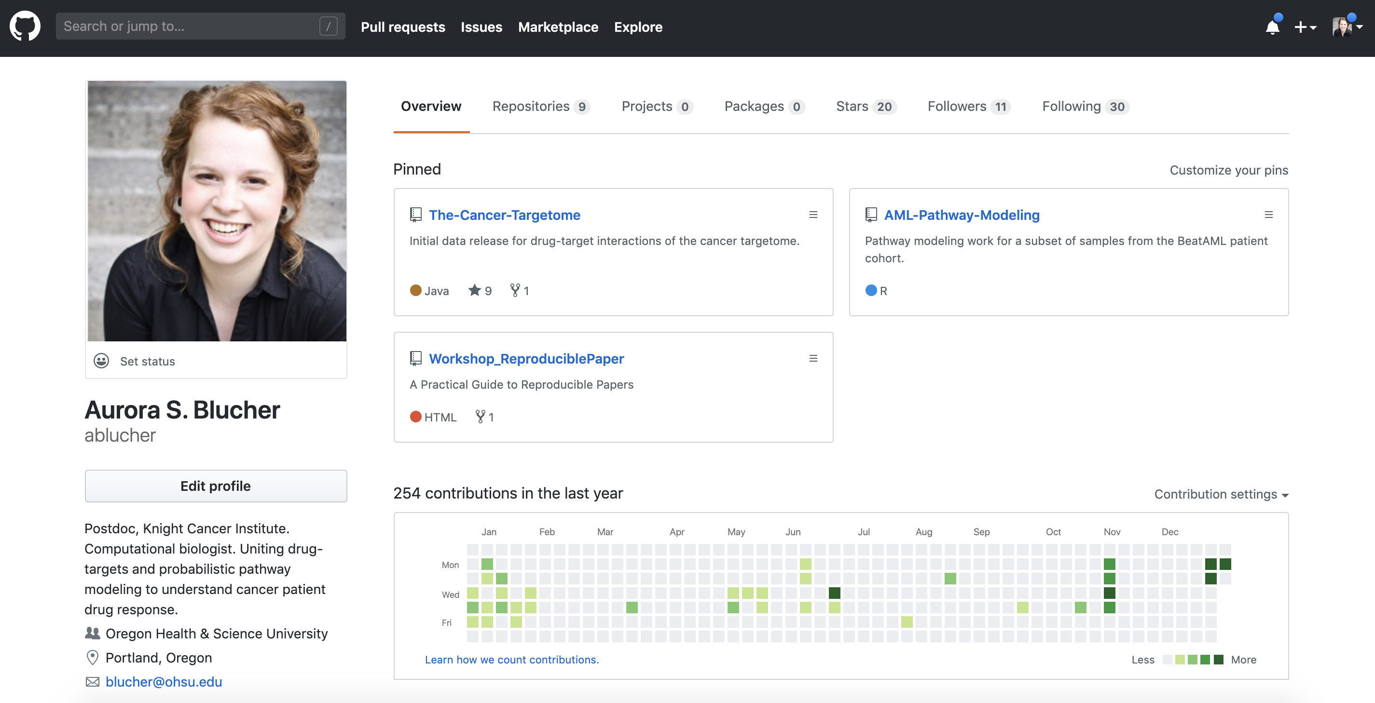
Give Projects a Home with GitHub Repositories
Great for project management!
Open (private/public options)
Not necessarily tied to an institution/group
Add collaborators with more privileges
Part of your research portfolio
Notes:
-GitHub is really more than version conrol
-great way to think about managing projects/collaborations
-you can start projects as private, then move them over to public as you get read for manuscript publication

Slide 8
Creating a roadmap for your work

Slide 9
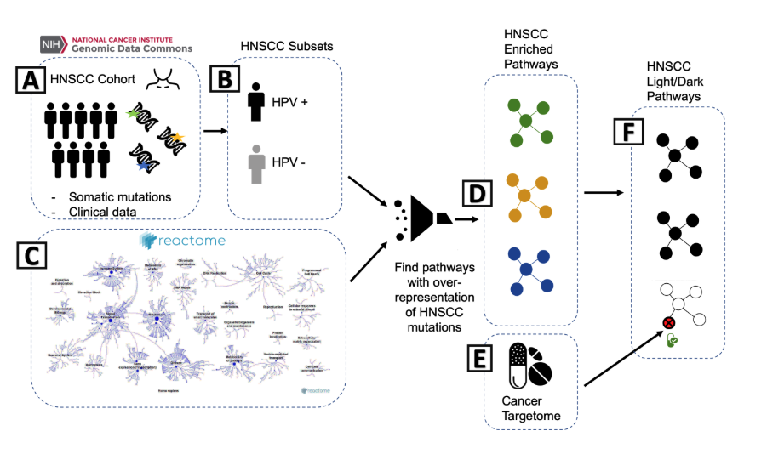
Your Overview Figure
…and prepare to delegate
Notes:
-one way to to do this is to create a figure (=overview figure of your paper)
-if you force yourself to distill the project down to inputs/analysis/outputs, it becomes a lot clearer
-helps with communication of your work
-provides a roadmap for readers
-allows you to see main parts of project versus sub-analyses or more specific questions
-+ it’s also going to set you up for thinking about your *must haves* for reproducibility

Slide 10
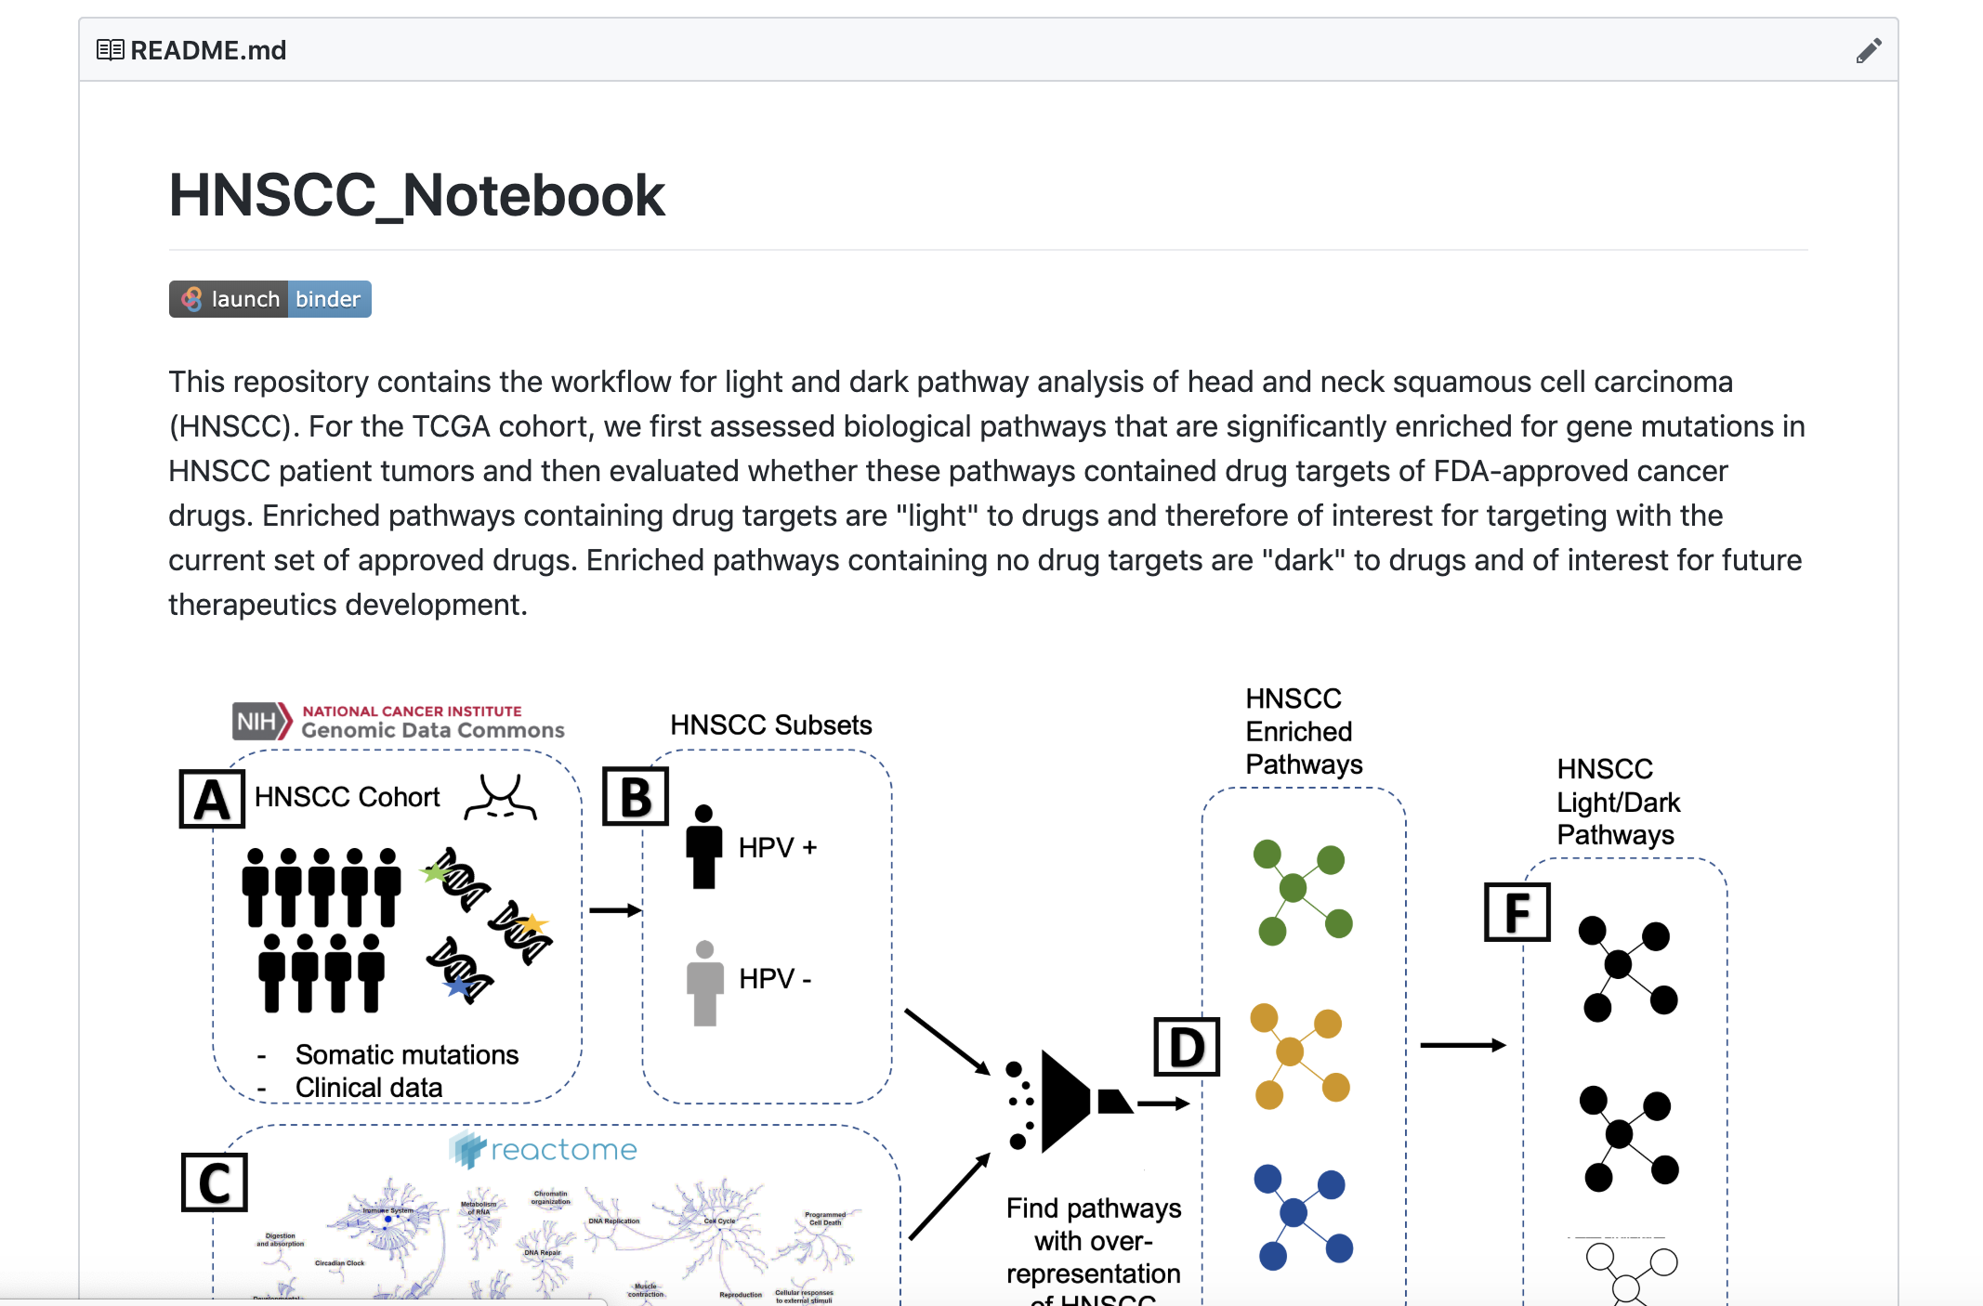
Use your GitHub README.md as a Project Overview
Notes:
-this is a great way to start your read me in a github project

Slide 11
Identifying your inputs/ analysis steps/ output

Slide 12
Identify key inputs-data files, pathway databases, annotation files
Notes:
-bonus this works great as Figure 1 in a manuscript

Slide 13
Identify key inputs-data files, pathway databases, annotation file
”Good Enough Practices in Scientific Computing”
Greg Wilson & Jennifer Bryan. 2017.
Data set
TCGA Head and Neck Squamous Cell Carcinoma Cohort
Mutation Data
Copy Number Data
Cohort/clinical annotation
Best: include the open source, non PHI data files with your project
Next best: link to the public repository where data can be downloaded
Resources
Reactome pathway database
File of pathway IDs, names, and gene members
HPV status annotation file
Additional cohort annotation file
Cancer Targetome drug-target interactions file
Include versions/access dates, and any modifications or clean-up you’ve done
GitHub Repository
Notes:
-it helps me to think about it in terms of the patient/sample set – here TCGA cancer cohort
-then I think of references/resource files that are used in the analysis
-for reproducibility – these are the minimum files we need –for someone else to be able to re-create our work

Slide 14
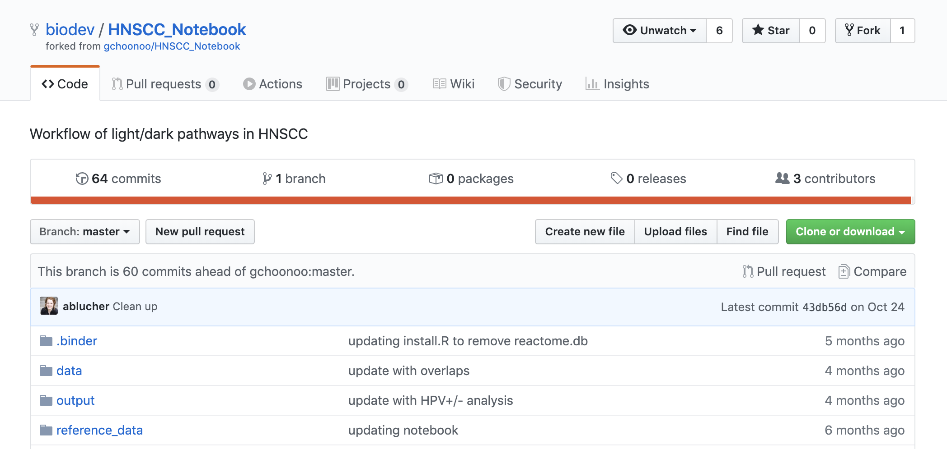
Good Practices in Project Organization
MyProject_Folder
>data
>R
>output
original_data, cleaned_data, resources
.R scripts, markdown files, notebooks
figures, tables, etc.

Slide 15
Identify key analysis steps

Slide 16
Good Practices in Project Organization
What are the main scripts used for analysis?
versus exploratory/one-off scripts
Do they run?
Are input files and output files clearly described?
Packages/dependencies at top of scripts
Helpful commenting
GitHub Repository
Great stage for a code review/ coding buddy
http://ropensci.org <- open code reviewers for scientific R packages
Notes:
-today’s workshop isn’t focused on analysis or coding, but rather how we pull all this together
-some aspects you need to consider at this stage

Slide 17
here() package in R
looks for .Rproj file
here() makes this your root directory
all file paths now relative to root
MyProject_Folder
>data
>R
>output
>library(here) #attach library
>here() #show me my root directory
>myfile<-read_csv(here(“data”, “myfile.csv”)) #read in file
cross-platform compatible file paths
Can move an Rmarkdown report anywhere in project and will still execute
Notes:
-the here package is going to be your best friend!
-Ted showed me this package and it was very easy to use with a lot of gains
-makes it easy to open up an R project and get to work where you were
-cross-platforms – windows/mac
-you can move your whole project and all file paths still work

Slide 18
Identifying your inputs/ analysis steps/ output
Separate out any sub-analyses

Slide 19
Identify key analysis steps
Do you have similar sub-analyses?

Slide 20
Consider adding workflow figures
Differentiate between sequential versus parallel tasks
Sample sizes,
coverage, serve as reproducibility landmarks

Slide 21
Identify key outputs
Notes:
-bonus this works great as Figure 1 in a manuscrupt

Slide 22
Recreating Your Results

Slide 23
Where do all my figures and tables come from?
Figure 2. A and B.
Created within R scripts
Figure 5.
Created in another software application
(Cytoscape/ ReactomeFIVIz)

Slide 24
Recreating Your Results
Don’t forget your supplemental!

Slide 25
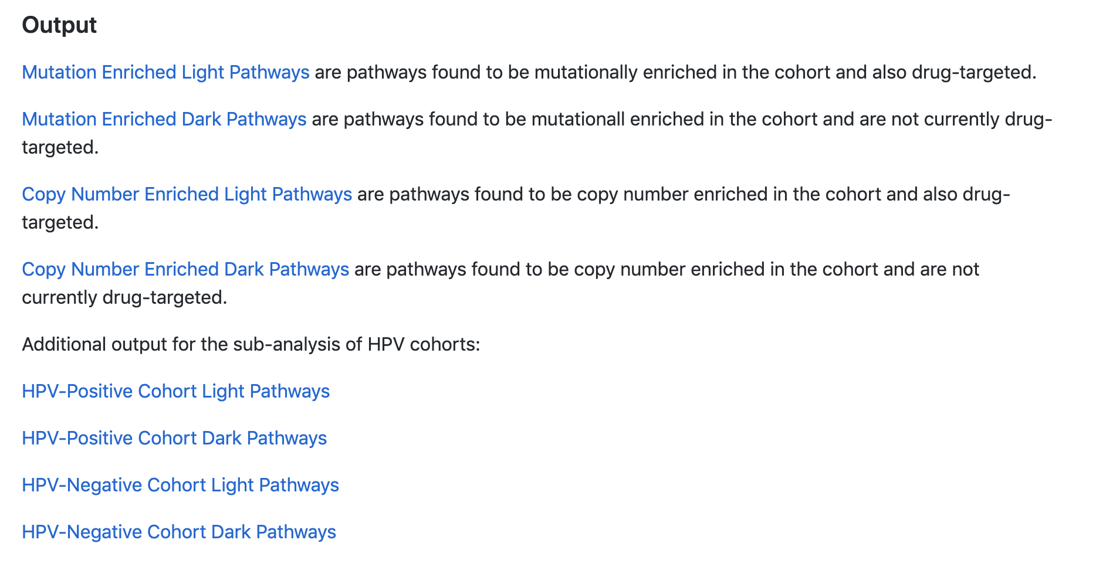
Good Practices in Project Organization
Make a clear path to your outputs
Imagine you are guiding a friend who is excited about your research!
Add links to key outputs directly in your README.md
Notes:
-supplemental material are often what people are interested in
or you may just need 1 or 2 files for future work

Slide 26
Code Reproducibility

Slide 27
Literate programming/ R markdown notebooks
Walk-through R markdown notebook
Notes:
-so to facilitate all of this -> there are practices we can use for more reproducible methods and code bases

Slide 28
Reproducible Software Environment
Best Practice is to reproduce the entire software environment used in analysis
Many tools for this that are language specific: R: renv and Python: virtualenv
Docker: lets you reproduce the entire software environment (analysis software versions, software dependencies and software packages needed) in a OS independent manner
Need to specify packages and versions (use tags to specify releases)
Don't get too dependent on any one install of software – ensure that your analysis can be run across OSes and versions
Notes:
-so to facilitate all of this -> there are practices we can use for more reproducible methods and code bases

Slide 29
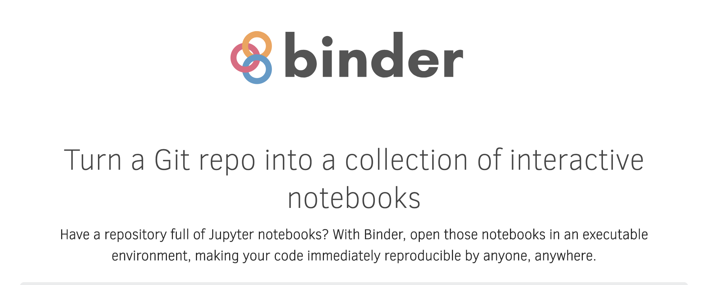

Slide 30
Creating a “Binder”
=
Creating a “Binder-Ready” Repository (e.g. Git Repo)
=
Your Repository + Code + Configuration Files
Notes:
-so to facilitate all of this -> there are practices we can use for more reproducible methods and code bases

Slide 31
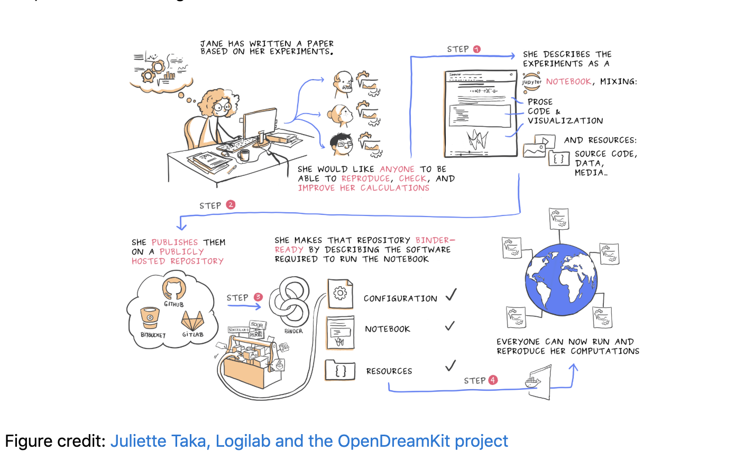

Slide 32
Hands On - Setting up a Github Repository/Compendia for Binder
Github repository (public)
R markdown notebook
Configuration for Binder
Option 1. install.R and runtime.txt
install.R #R script that with install.packages() calls
runtime.txt #specify R version here
Option 2. Docker file set up
binder/ Dockerfile
More info: Research Compendium: https://research-compendium.science/
Holepunch Package for Binder: https://github.com/karthik/holepunch
Demo for today
Alternate option
Notes:
-go through each of these steps in the repository
-repository set up
-R markdown notebook
-configuration for binder

Slide 33
http://bit.ly/bdc_binder

Slide 34
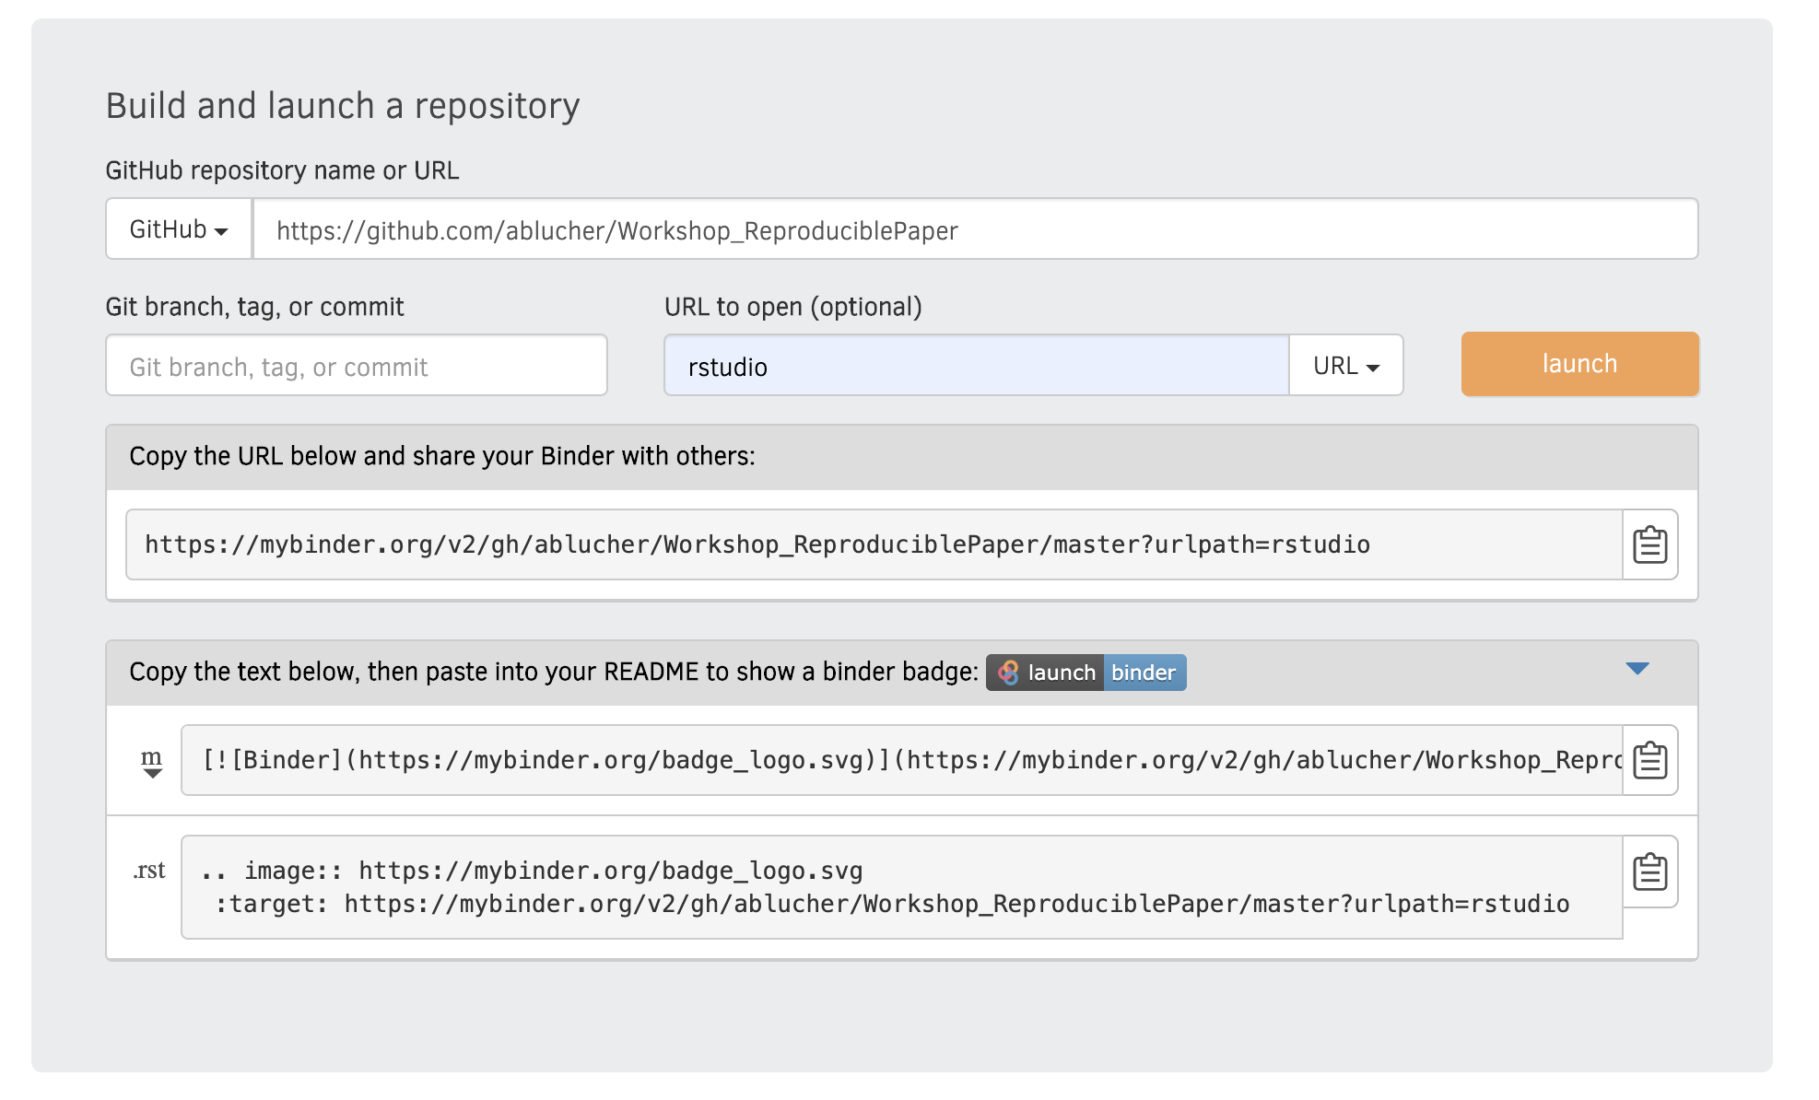
mybinder.org
This will take a while the first time you build your binder!
Notes:
-will use mybinder.org directly in the workshops
-example screenshot in case we need

Slide 35
How Docker Operates Behind the Scenes (repo2docker)
Docker = a program to let you run multiple operating systems on your computer
We use Docker to specify our software environment as an image and run it as a container
Images versus containers
Images are the definition for the operating systems
Containers are the actual running instance
Option #2 is using Dockerfile to build our image
Dockerfile = configuration file
Docker and R Reproducibility https://colinfay.me/docker-r-reproducibility/

Slide 36
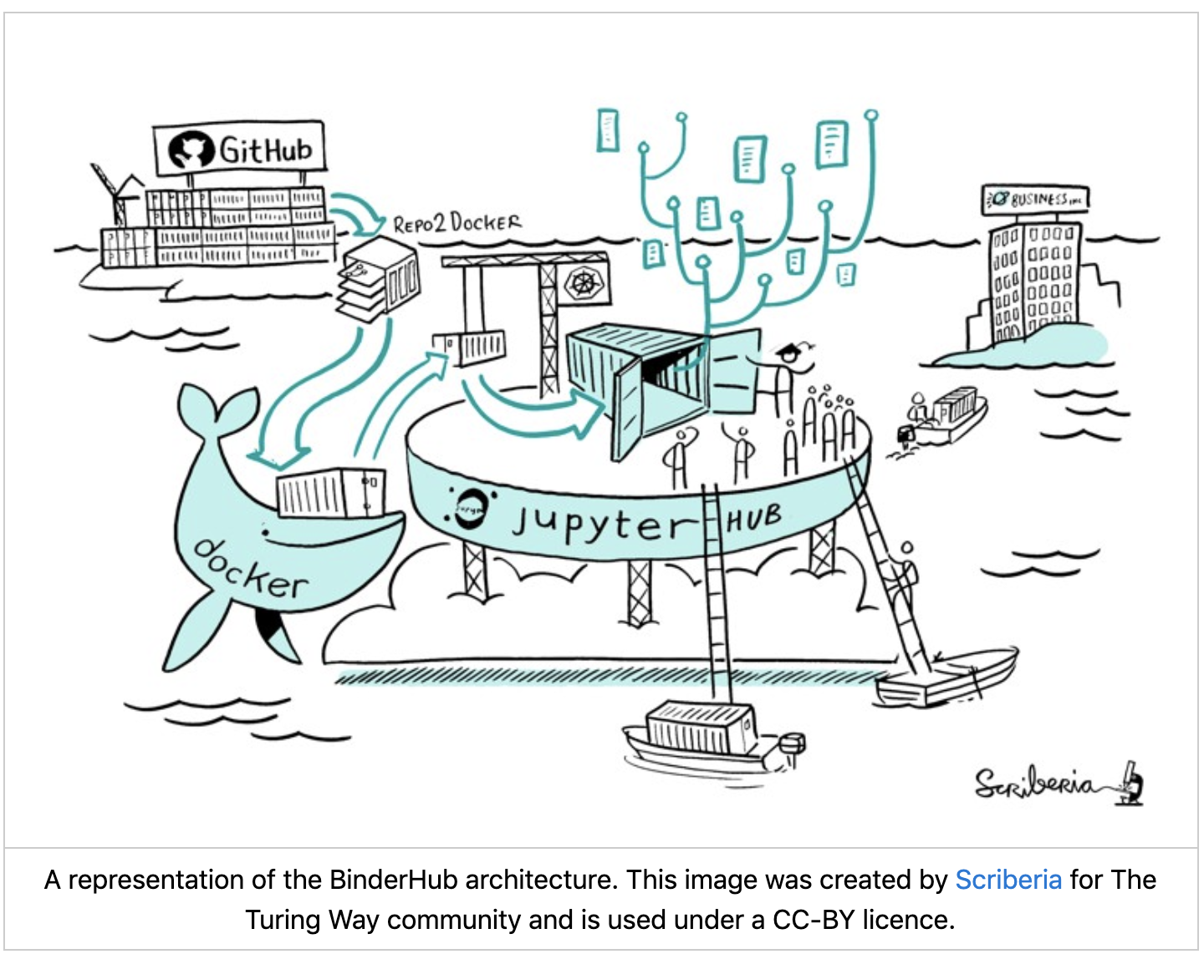
What’s going on behind the scenes?
Notes:
-Mybinder.org, which we are using -> is a free and public Binderhhub (you can also build your own – Ted has talking point here/ Research Data Network)
-Repo2Docker is a tool
it goes out and fetches your git repository/ build a container image based on your configuration files
-your docker image has all your code/ resources/ dependencies/ data (if it’s in your repository) / software required to run your code
-JupyterHub is a server, usef for jupyter notebooks and containers – here it’s important because it connects your browser to the binderhub instance that’s on the kubernates clusters
-Kubernates cluster (not shown) – system for managing containers on a computer cluster

Slide 37
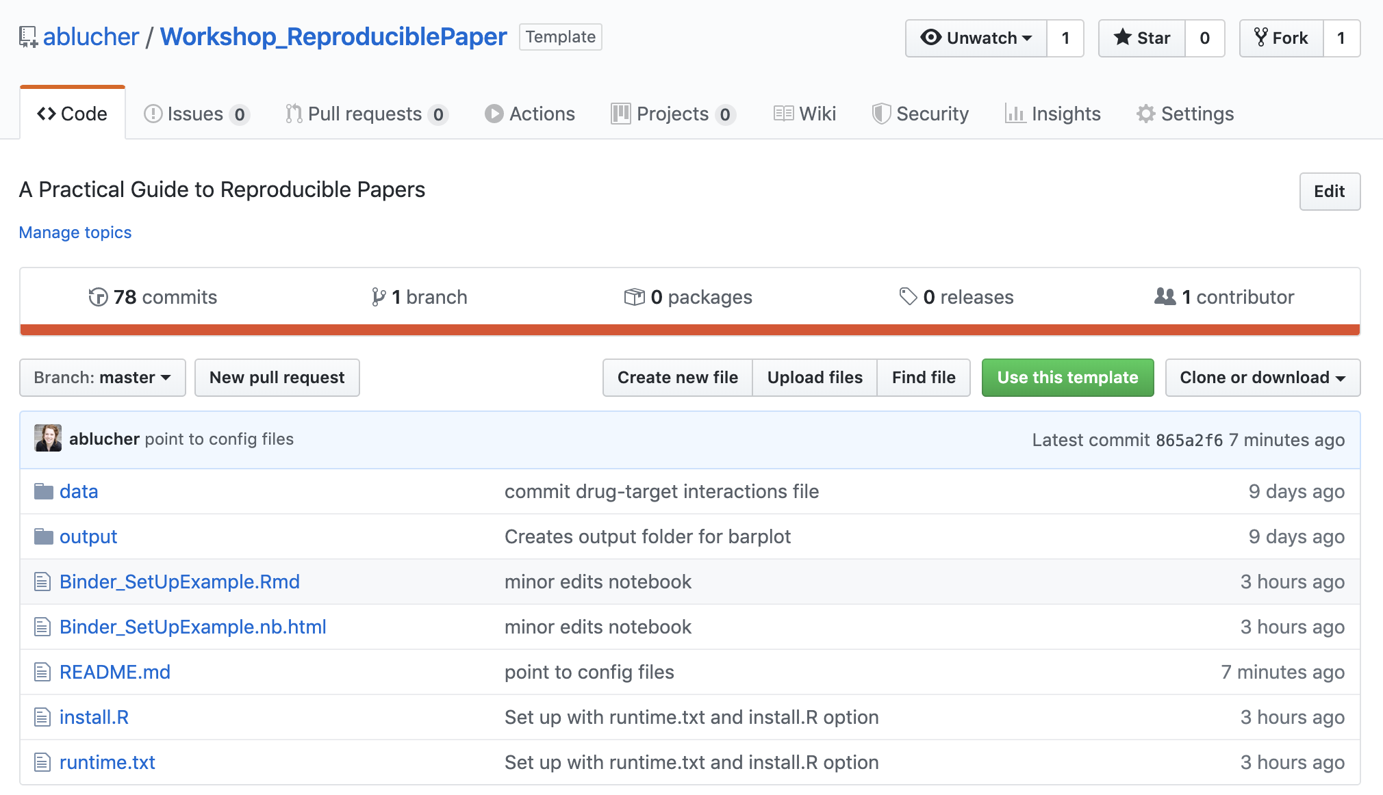
Using This Workshop as a Template

Slide 38
Good Practices for GitHub Project Management

Slide 39
Making Version Control Work For You
Make sure all your files are in the repository
Add numbering to your figures and tables to match manuscript drafts
Clean up duplicate files
Remove outdated versions (version control means you have a history!)
A Quick Guide to Organizing Computational Biology Projects:
https://journals.plos.org/ploscompbiol/article?id=10.1371/journal.pcbi.1000424

Slide 40
Bonus Round: Sub-analyses and annotation files

Slide 41
Sub-analyses and annotation files
Adding annotation
Flag columns, date columns, curator columns
Add a README (can be tab in spreadsheet)
Explain to someone else <-> have a buddy
Don’t be afraid of manual annotation steps – they often are information rich and incredibly valuable!!
But you need to leave a paper trail
HPV status annotated from 3 primary sources
-methods write-up
-citations for original papers
-README that explains the annotation file
Notes:
-also, often times these sub-analyses are done in separate scripts, or very quickly (maybe to prep for a meeting)
-take some time to document them and bring them into the rest of your code base/ project

Slide 42
Final Thoughts
Protocol/ Methods Documentation
Iterative Process
Have a tester! Partner up with some for code review!
Time/effort commitment for reproducibility is non-trivial

Slide 43
Acknowledgements
Ted Laderas | Pierrette Lo
Biodata Club
Head and Neck Squamous Cell Carcinoma Precision Medicine Group
Shannon McWeeney & Molly Kulesz-Martin
Gabrielle Choonoo | Mitzi Boardman | James Jacobs | Christina Zheng |
Samuel Higgins | Sophia Jeng | Steve Chamberlin | Nate Evans | Miles Vigoda |
Chase Mathieson | Ben Cordier | Ashley Anderson

Slide 44
Additional/ Backup Slides

Slide 45
How Docker Operates Behind the Scenes (repo2docker)
Docker = a program to let you run multiple operating systems on your computer
We use Docker to specify our software environment as an image and run it as a container
Images versus containers
Images are the definition for the operating systems
Containers are the actual running instance
Option #2 is using Dockerfile to build our image
Dockerfile = configuration file
Docker and R Reproducibility https://colinfay.me/docker-r-reproducibility/

Slide 46
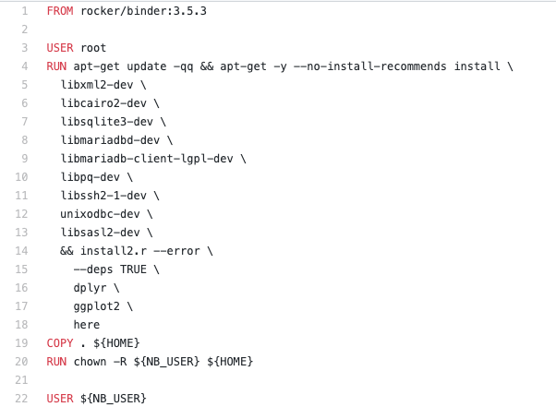
What’s in our Docker file? Example docker file from Ted

